Slide 1

CSCE 760 Project Firewall implementation on DPDK
Sergio Elizalde, Amith GSPN, Samia Choueiri
Department of Integrated Information Technology
University of South Carolina
December 1, 2025
Notes:
samia

Slide 2
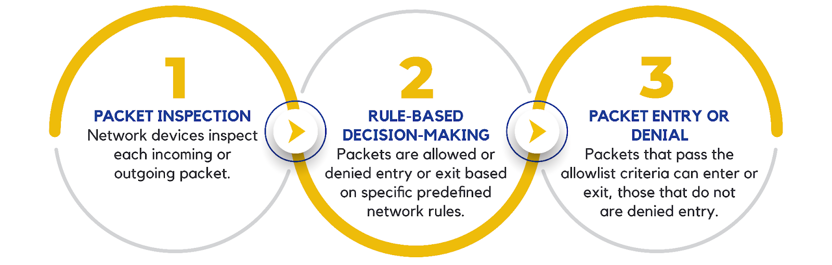
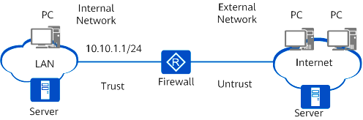
System overview
Developing a packet filter system designed to control and secure the flow of network traffic between an internal network and an external network.
Notes:
Samia

Slide 3
System overview
Primary Users
Network administrators – configure and manage filtering rules.
Internal network users or devices – rely on the filter to safely communicate with the outside world.
Core System Functions
Outbound packet forwarding
Inbound packet blocking
Rule enforcement based on security policies
Report system statistics
Notes:
Samia

Slide 4
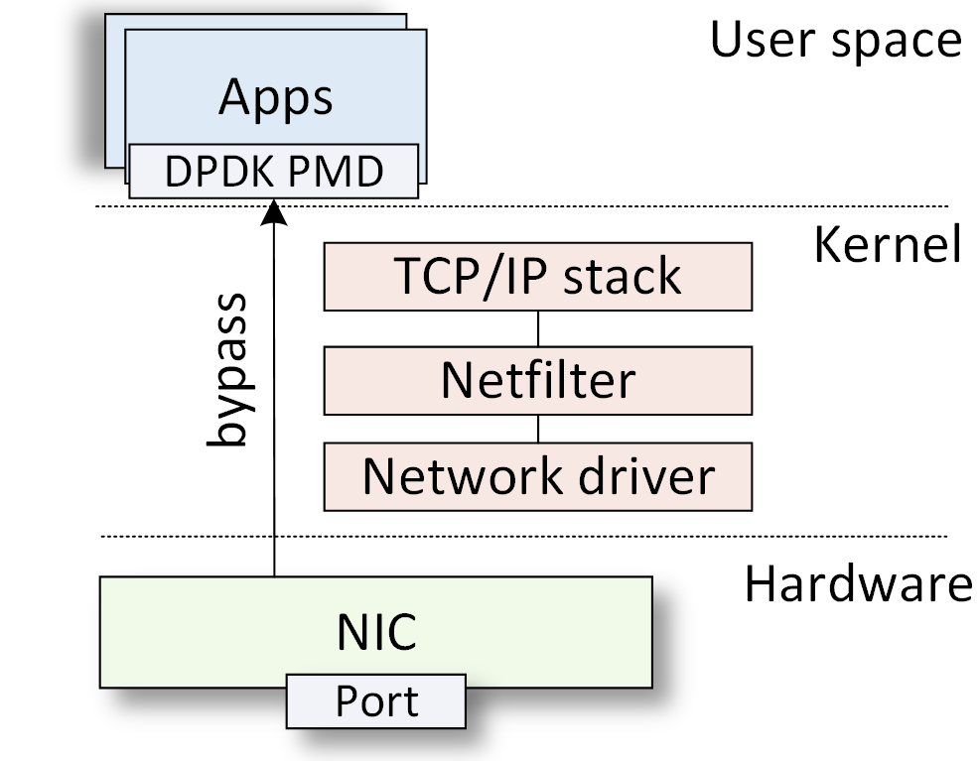
Data Plane Development Kit (DPDK)
Stateless firewalls implemented using DPDK achieve superior performance over the kernel-based implementation.
DPDK is a platform for accelerating packet processing.
It adopts kernel bypass and zero-copy principles.
DPDK-based firewalls are implemented in user-defined pipelines.
Notes:
Samia

Slide 5
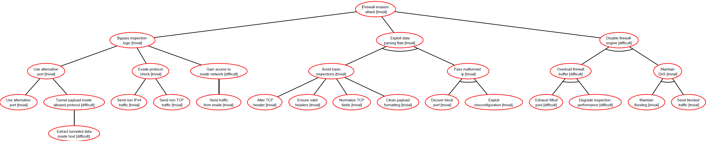
Attack tree

Slide 6
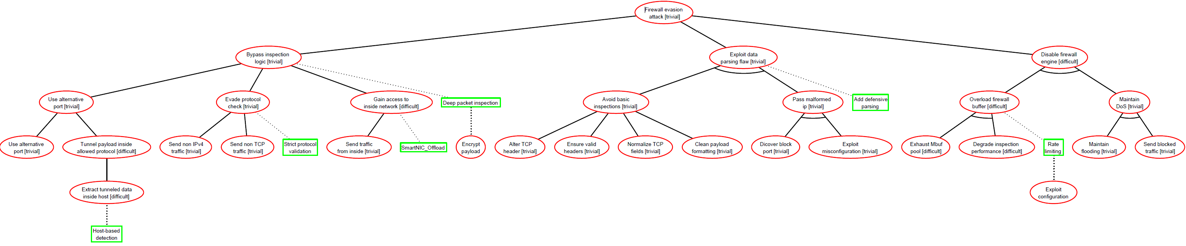
Attack Defense tree

Slide 7
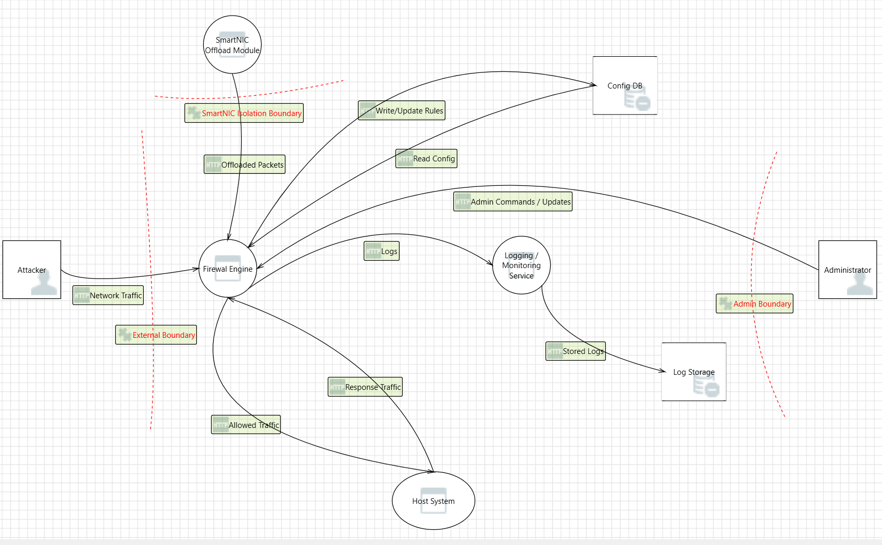
Threat Modeling
Notes:
Amith

Slide 8
Structured Design
Decomposition and Modularization: Break all in on huge code into separate modules
Coupling and cohesion: Make sure each module operate independently
Abstraction: Reduce C language complexity (e.g., use struct to hide parsing logic)
Separation of Interface and Implementation: Don’t mix headers with full implementations
Encapsulation and Information Hiding: Encapsulate to maintain internals private
Sufficiency, Completeness and Primitiveness: Each function does one operation at a time
Notes:
Sergio

Slide 9
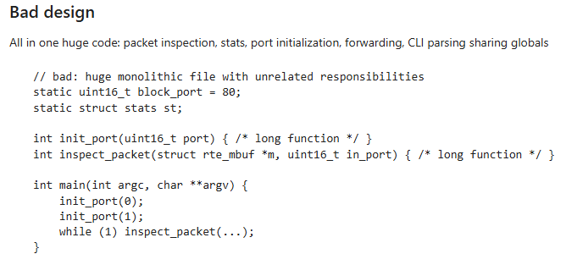
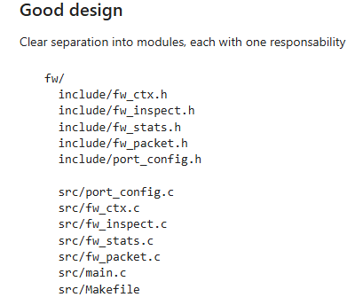
Examples
1. Decomposition and Modularization
Notes:
Sergio

Slide 10
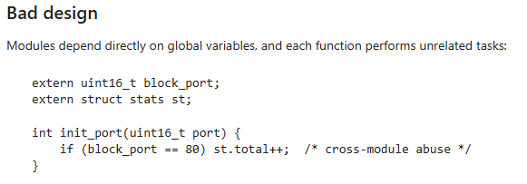
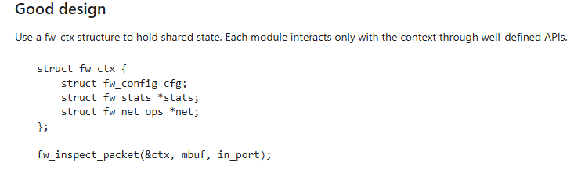
Examples
2. Coupling and Cohesion
Notes:
Sergio

Slide 11
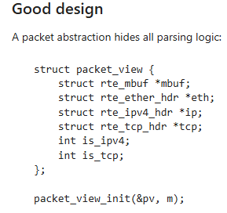
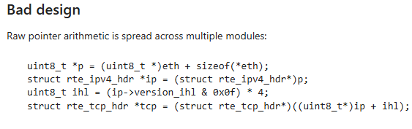
Examples
3. Abstraction
Notes:
Sergio

Slide 12
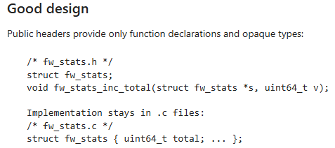
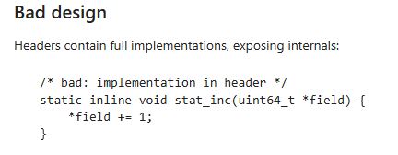
Examples
4. Separation of Interface and Implementation
Notes:
Sergio

Slide 13
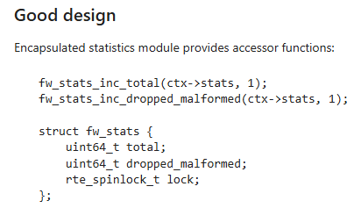
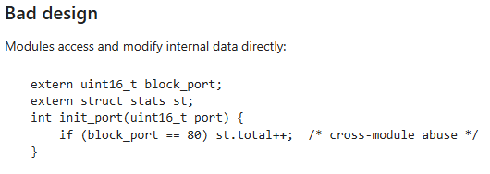
Examples
5. Encapsulation and Information Hiding
Notes:
Sergio

Slide 14
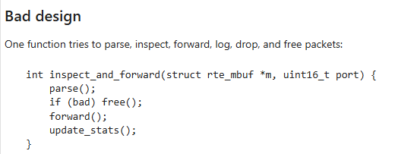
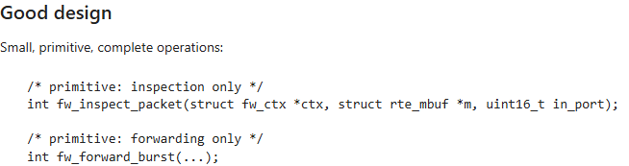
Examples
6. Sufficiency, Completeness, and Primitiveness
Notes:
Sergio

Slide 15
Secure Programming
Rank | Weakness | BaseFinding | AttackSurface | Environmental | CWSS
1 | Improper Packet Validation | 80.0 | 95.0 | 77.0 | 58.6
2 | Resource Exhaustion | 59.5 | 95.0 | 78.0 | 44.1
3 | Missing Authentication | 65.5 | 77.5 | 67.5 | 34.3
4 | Hardcoded Trust Boundary | 62.5 | 63.5 | 66.0 | 26.2
5 | Weak Logging | 41.5 | 54.5 | 49.0 | 11.1
Notes:
Samia

Slide 16
Testing
To run Splint, we created a C code that mimics DPDK workflow.
Four main functions:
Memory allocation for packets
Validate the packet bounds
Initialize ports
Inspect packet
The buggy code contains some of the following warnings:
Type Mismatches & Unsafe Conversions
Memory Allocation & Initialization Issues
Uninitialized or Undefined Storage Usage
Several functions are exported but never used outside the file (should be static)
The corrected code addresses these issues by:
Use consistent types
Initialize memory and assign a value to each field
Check errors when allocating memory
Freed memory in all paths
Notes:
Amith

Slide 17
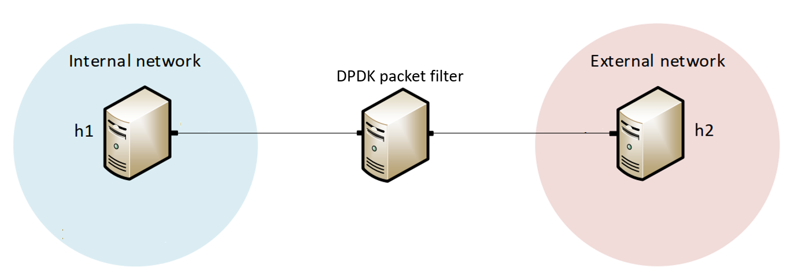
Experiment Topology
Notes:
Samia

Slide 18
Experiment Topology
Notes:
Samia

Slide 19
Experiment Topology
Notes:
Samia

Slide 20
Experiment Topology
X
Notes:
Samia

Slide 21
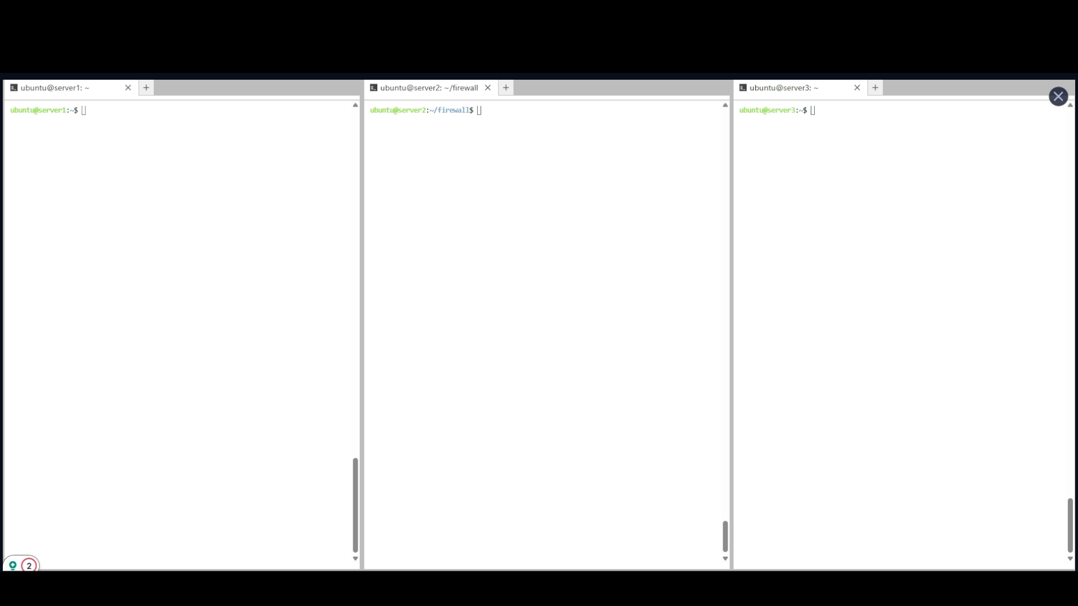
Demo
Notes:
Samia

Slide 22
THANK YOU!
Notes:
Sergio

